Slide 1

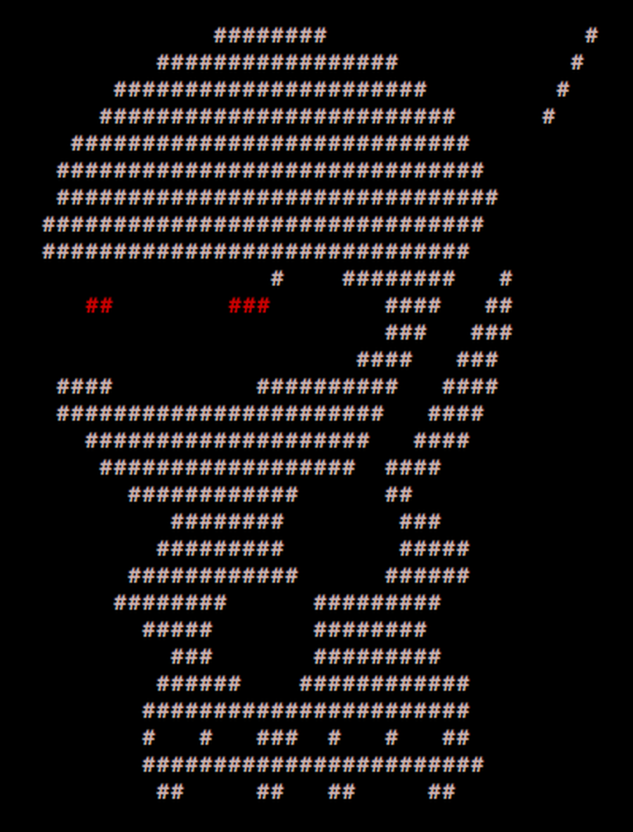
____ _____ _ _
/ ___| ___ __|_ _|_ _| | | _____
\___ \ / _ \/ __|| |/ _` | | |/ / __|
___) | __/ (__ | | (_| | | <\__ \
|____/ \___|\___||_|\__,_|_|_|\_\___/
PER0x57
Technical (in)security talks & hands-on challenges, no bullshit!
Technical (in)security talks & hands-on challenges, no bullshit!

Slide 2

Welcome!
We’re back!
Merry Christmas nerds
Technical (in)security talks & hands-on challenges, no bullshit!

Slide 3
SecTalks PER0x57
Thanks to…
Evildaemond, sudosammy, nidogski, ParaFlare, Trustwave, Matt Jones for the brews!
Spacecubed & Riff!
The committee: nidogski & sudosammy
Everyone who contributes!
Technical (in)security talks & hands-on challenges, no bullshit!
Notes:
Have a line up of lightening talks tonight

Slide 4
SecTalks PER0x57
1,093 meetup.com members!
2020
Only 6 meetups :(
Average RSVP count: 61
Attendance is typically +/- 10
Total RSVPs: 367
Technical (in)security talks & hands-on challenges, no bullshit!
Notes:
Have a line up of lightening talks tonight

Slide 5
SecTalks PER0x57
1,093 meetup.com members!
2021
10 meetups! :)
Average RSVP count: 60
Attendance is typically +/- 10
Total RSVPs: 542 + December (equals low 600’s!)
Technical (in)security talks & hands-on challenges, no bullshit!
Notes:
Have a line up of lightening talks tonight

Slide 6
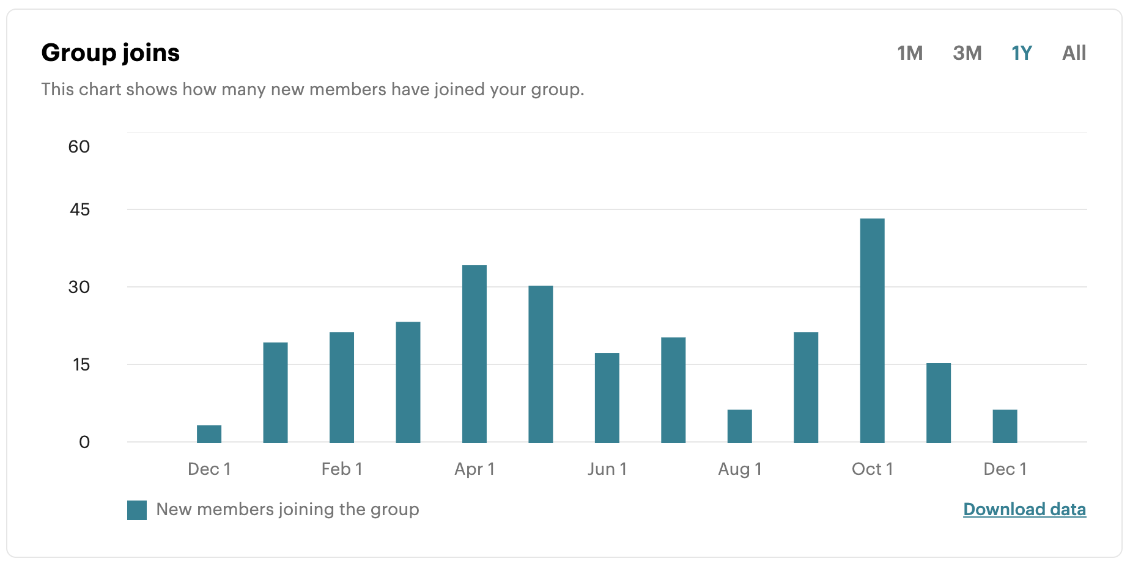
SecTalks PER0x57
Technical (in)security talks & hands-on challenges, no bullshit!
Notes:
Have a line up of lightening talks tonight

Slide 7
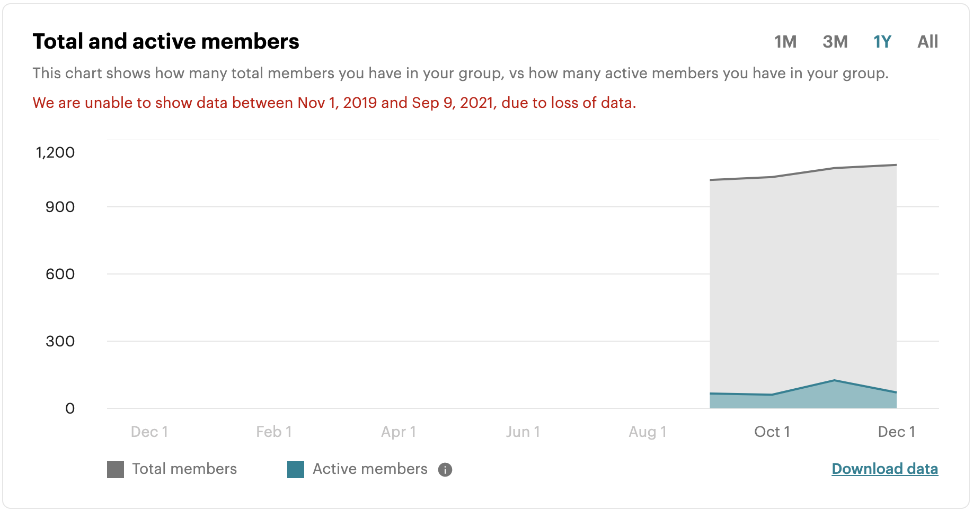
SecTalks PER0x57
Technical (in)security talks & hands-on challenges, no bullshit!
Notes:
Have a line up of lightening talks tonight

Slide 8
SecTalks PER0x57
WTF!
Technical (in)security talks & hands-on challenges, no bullshit!
Notes:
Have a line up of lightening talks tonight

Slide 9
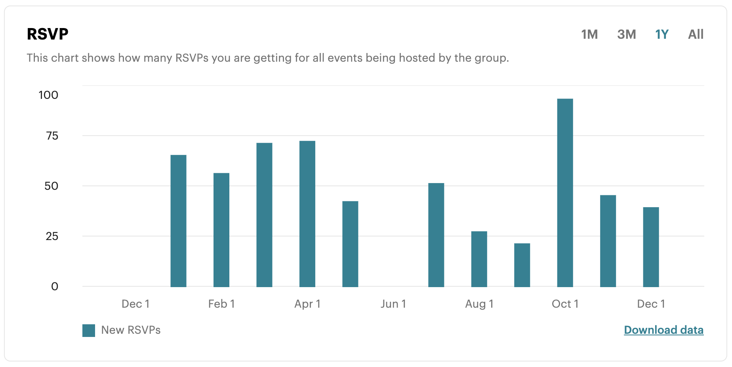
SecTalks PER0x57
Technical (in)security talks & hands-on challenges, no bullshit!
Notes:
Have a line up of lightening talks tonight

Slide 10
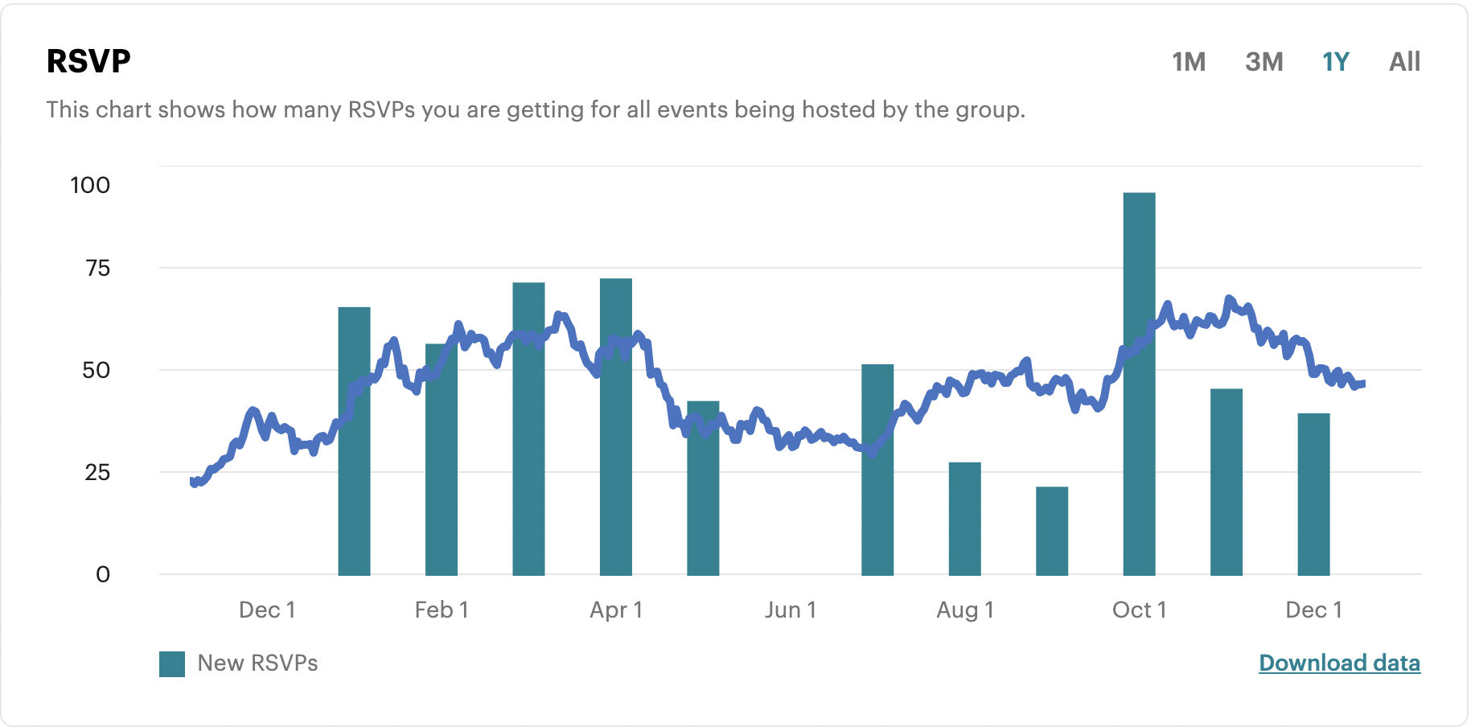
SecTalks PER0x57
Technical (in)security talks & hands-on challenges, no bullshit!
Notes:
Have a line up of lightening talks tonight

Slide 11
Speakers PER0x57
#1 – Chloe Fletcher Synopsis: A chat about a few of the more common compliance frameworks (ISO27001/PCI:DSS and also RFFR. Most people have had little experience with the compliance side of IT Security but because I’ve had to do our RFFR single handed, it’s kind of been a huge chunk of my life, the last six months! ALSO... DEMOS! Bio: Currently the Head of IT for SMYL, a not for profit dealing with under-privileged people and youth, throughout WA.
Technical (in)security talks & hands-on challenges, no bullshit!
Notes:
Conor is an evolutionary mass of atoms whose sole instinct is survival. Works as a Security Analyst who primarily focuses on detection engineering and data analysis – finding data, gathering data, parsing data, employing that data to do wonderful things. He embodies the ‘fuck around and find out’ mindset and applies it to every project.

Slide 12

SecTalks PER0x58
Date: ????
(the randomest day of every month)
Speaker: ??? ← This could be you!
Title: ??? ← This could be anything!
https://goo.gl/4eT53i
Technical (in)security talks & hands-on challenges, no bullshit!

Slide 13

SecTalks PER0x58
And also…
Technical (in)security talks & hands-on challenges, no bullshit!

Slide 14



Stay in touch
IRC / SLACK
irc.sectalks.org > #sectalks
and / or ask to be added to the slack
Github
https://github.com/sectalks/sectalks
Twitter
@SecTalks
Technical (in)security talks & hands-on challenges, no bullshit!

Slide 15
Without further ado...
drinks?
~ ~
( o )o)
( o )o )o)
(o( ~~~~~~~~o
( )' ~~~~~~~'
( )|) |-.
o| _ |-. \
o| |_||_) | \ \
| | ||_) | | |
o| | / /
| |." "
| |- '
.========.
Technical (in)security talks & hands-on challenges, no bullshit!

